Slide 1
Bundh Nireekshan
Team: Asesinos De Insectos
Team Members
Shwetha.M
Akshatha.R
Dinesh.S
Naveen.B
Praveen Kumar.S
Swathi.S

Slide 2
Features
Usage of Satellite data and Machine Learning to predict if a breach may occur or not.
Metadata collection from the uploaded images.
OTP Verification.
Complaint Registration along with uploading of images.
Live Health card.
Breach alert sent to government officials.
Using image processing to automatically segregate the images.
Using IRSAT’s Remote Sensing data required soil properties can be obtained and predictions can be improved.

Slide 3
Implementing Logistic Regression [ML Algorithm] for sample data

Slide 4
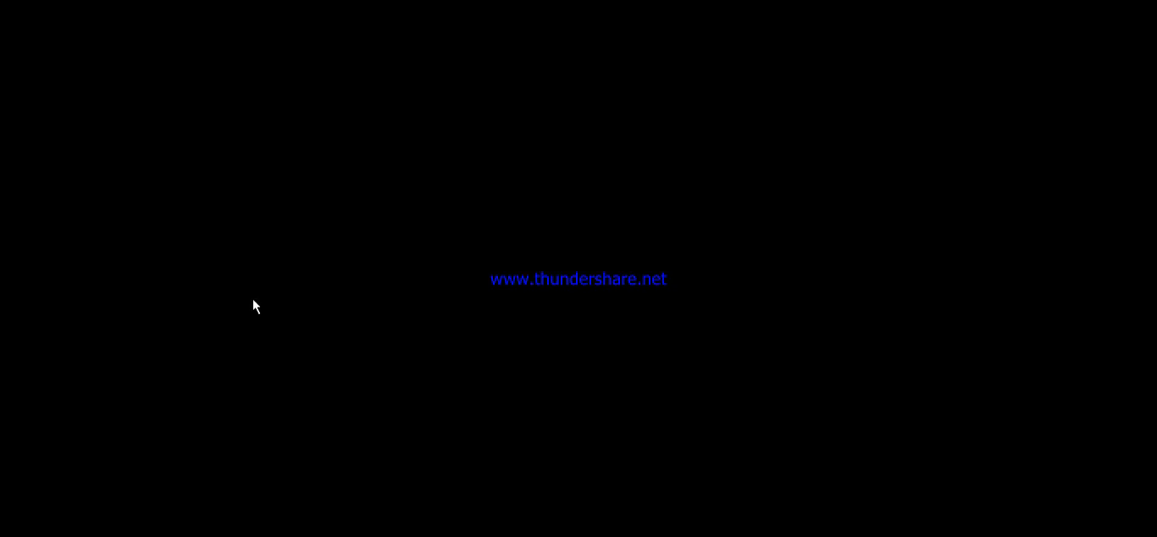

Slide 5
Health card Models

Slide 6
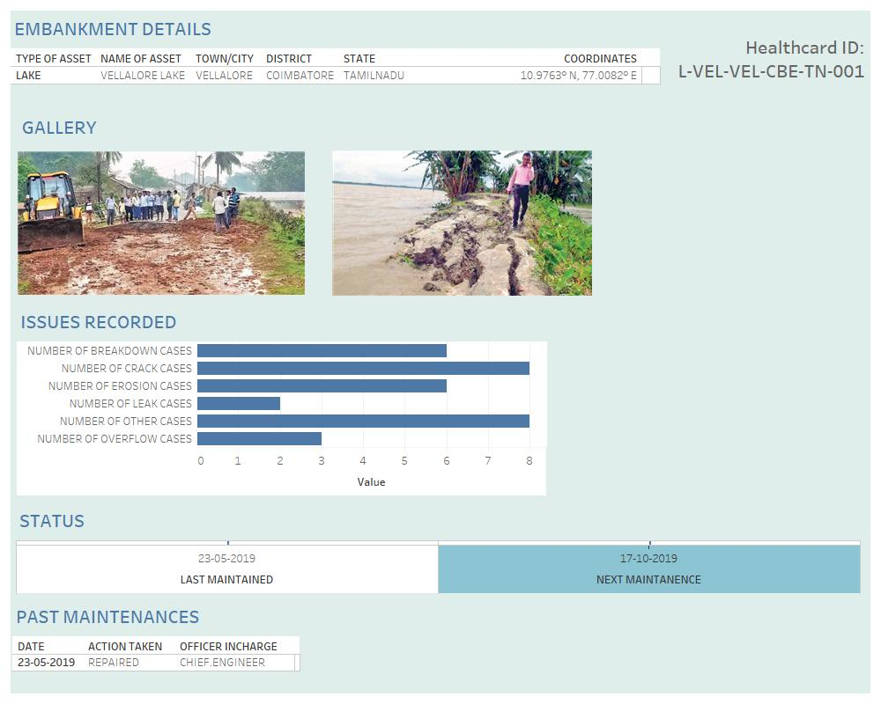

Slide 7
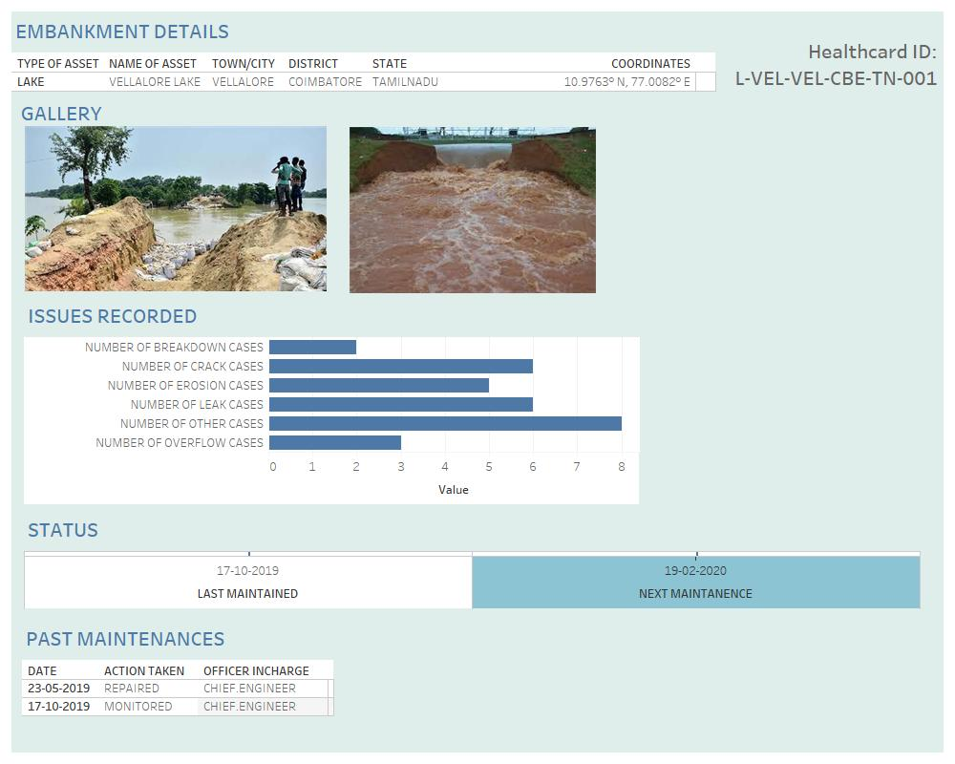

Slide 8
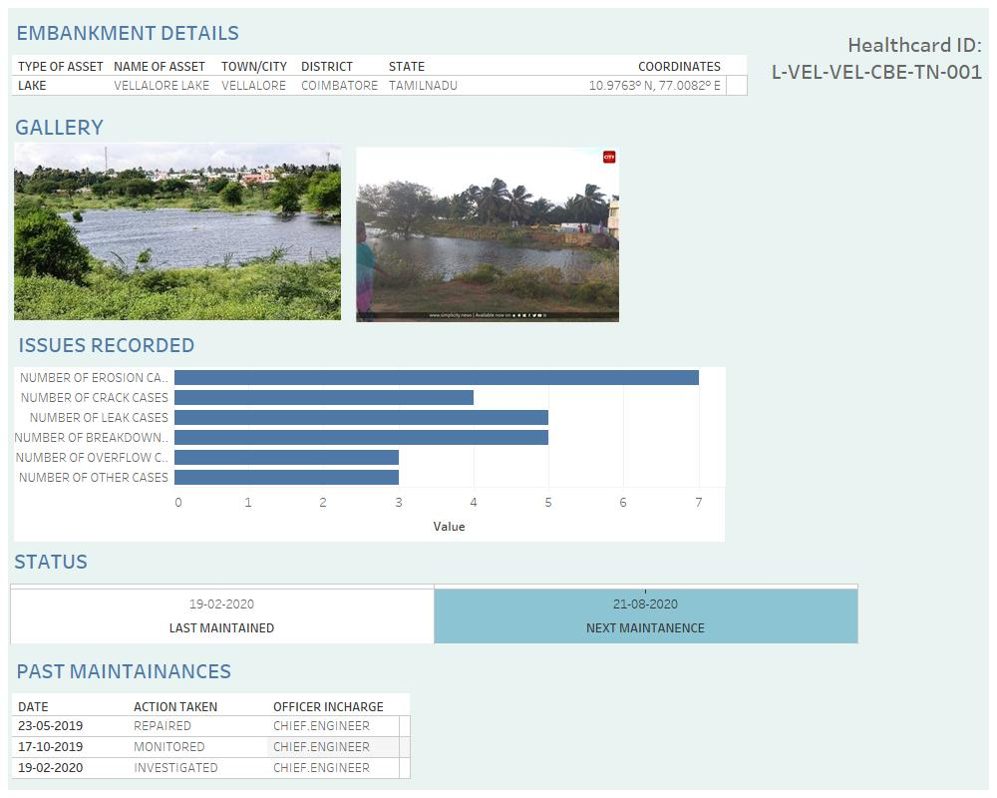

Slide 9





Live Interactive Dashboard
Analytics of the causes for embankments are recorded
The date and time of the recorded data are all displayed
Observed Data from the satellite is shown and processed
Images of the Embankment are displayed and viewed on-demand
Machine Learning Algorithm {Logistic Regression} is used to predict if a breach may occur or not

Slide 10

Breach alert sent to government officials.
Message alerts are sent to the government officials in case there is a high chance of embankment breach to take immediate action

Slide 11

Using image processing to automatically segregate the images.
The uploaded images are segregated into the issues faced automatically using image processing which is also used to recognize the difference in a healthy embankment and a damaged embankment. It is also used to classify the genuine pictures and fake pictures

Slide 12

Using IRSAT’s Remote Sensing data, required soil properties can be obtained and predictions can be improved.
Soil properties are recorded in the satellite through remote sensing and those data can also be included in the health card so that the predictions are even more accurate and the time interval between each recording can be reduced thus giving more precise predictions

Slide 13
Thank You

